Slide 1
Workforce Attrition
by: Joshua Yi

Slide 2
Intro
Analyzing Attrition in the workplace specifically Budweiser
Agenda:
Data understanding
Linear Regression
By Job
KNN, KNN Weighted, Logistic Regression and Lasso

Slide 3
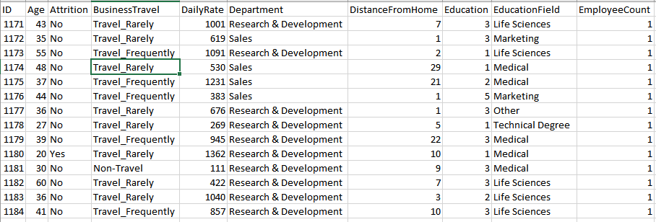
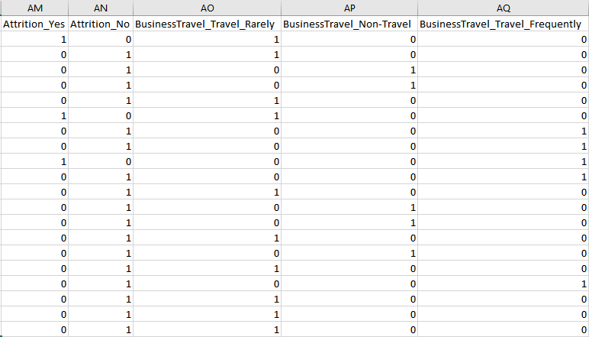
Data, Data and Some More Data

Slide 4
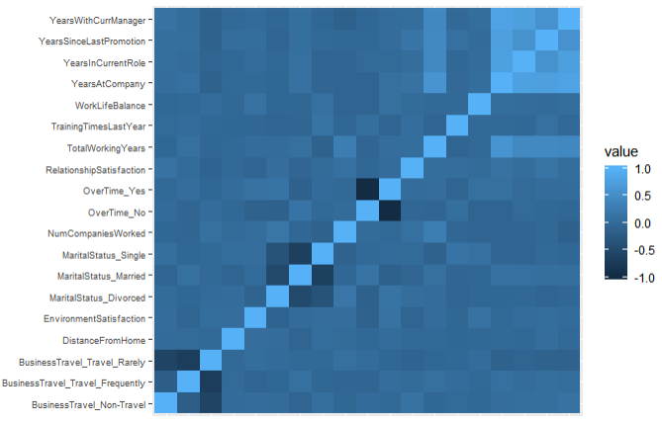
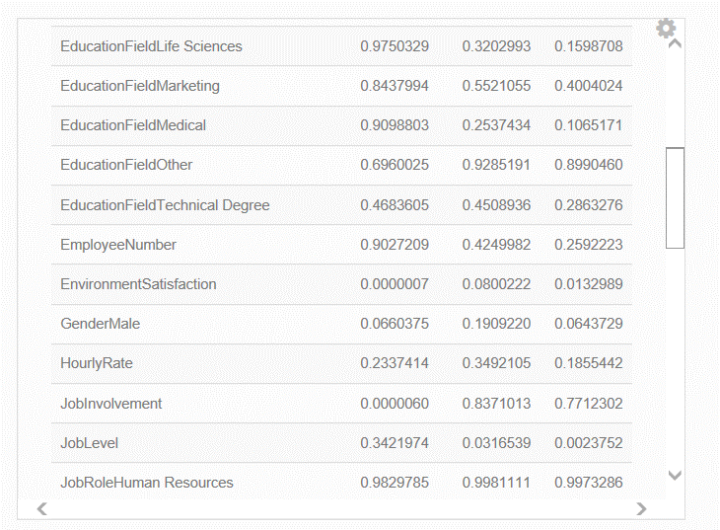
Factors?
Year Since Last Promotion
Business Travel Frequently
Environment Satisfaction

Slide 5
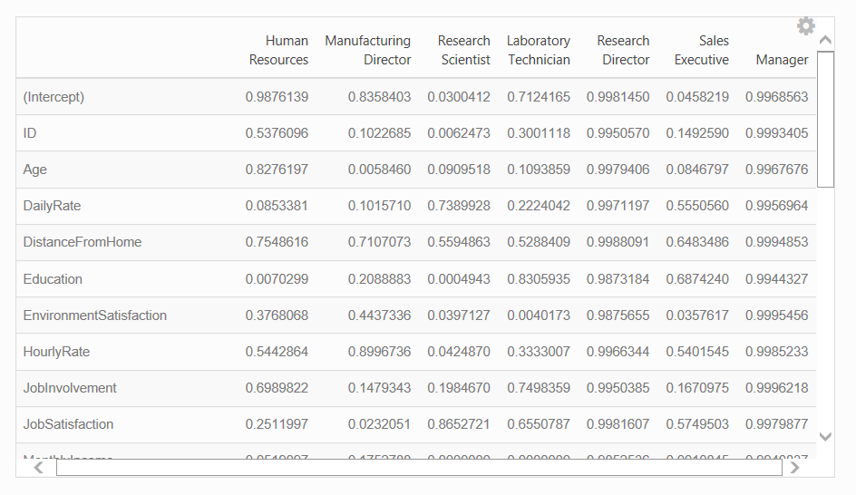
Factors differ by Job…and more
Gender
Martial
Status

Slide 6
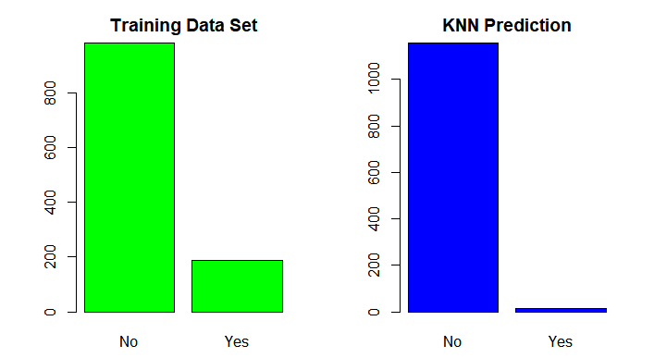
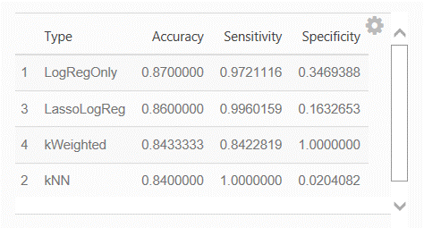
Models

Slide 7
YouTube Presentation Link
https://www.youtube.com/watch?v=wU10V0931FQ

